Slide 1
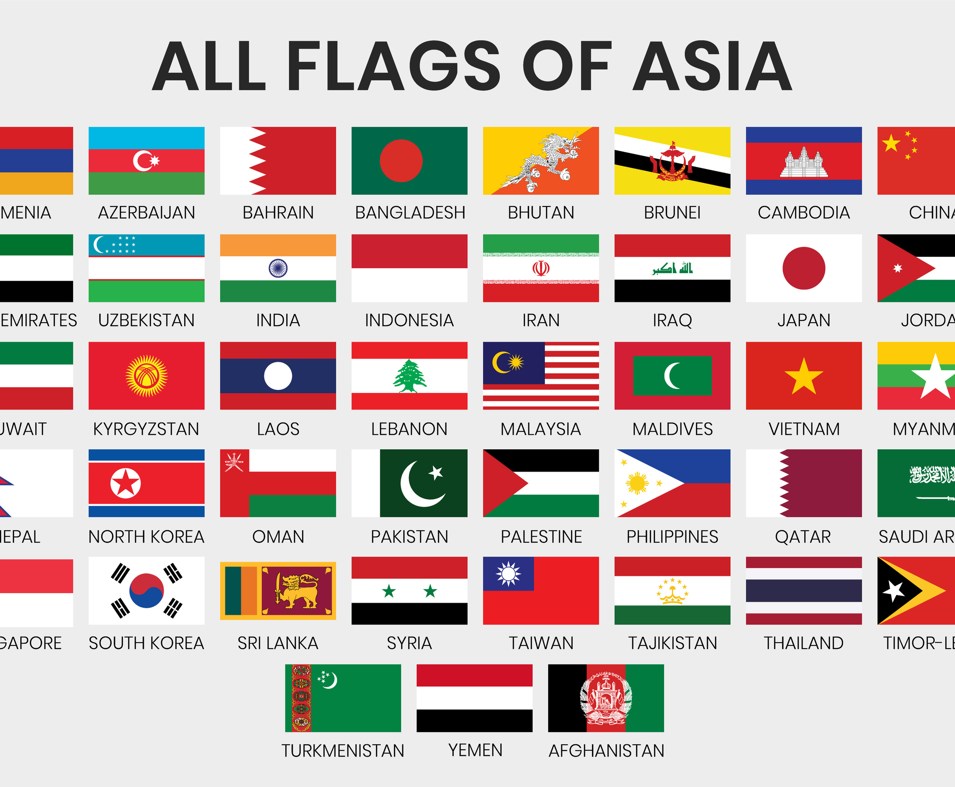
Annual Meeting
INS New Orleans | 13 February 2025
https://the-ana.org/

Slide 2
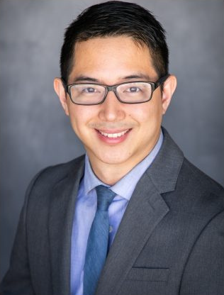
Presidential Address

Slide 3
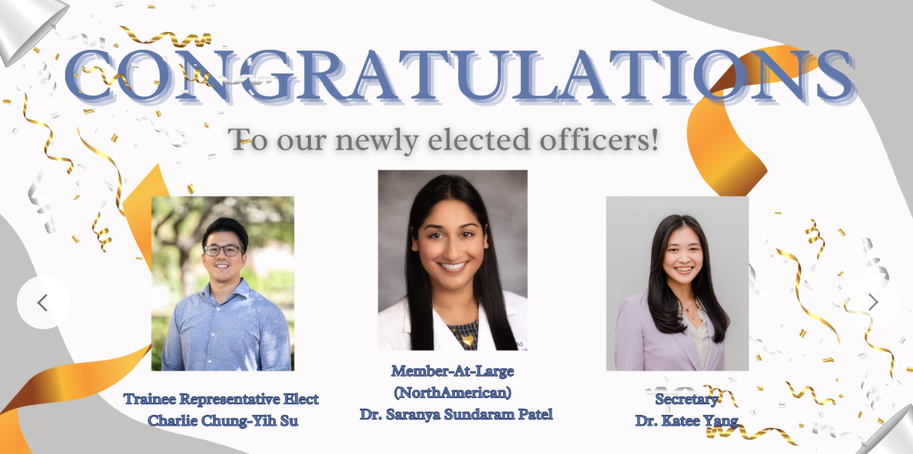

Slide 4
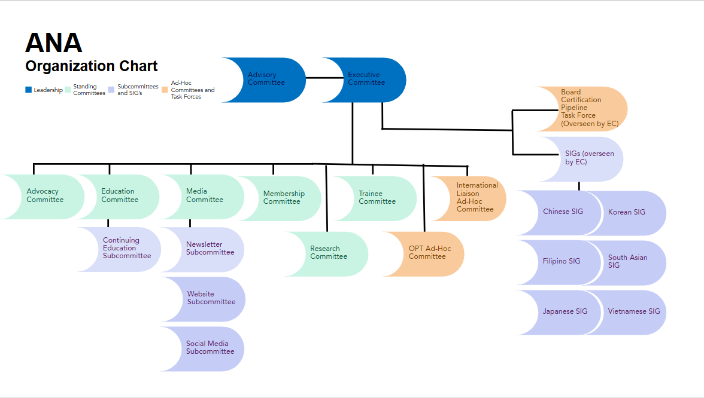
Notes:
Need to add new org chart with Research Committee (Chris will update)

Slide 6
ADVOCACY Committee
Dissemination of Advocacy Resources and Opportunities
Bimonthly Equity and Advocacy Bulletins, see past issues here
Letter template titled “Statement on protecting and promoting equitable clinical training and treatment standards” to encourage engagement in advocacy around policy that could put training relevant to cultural competence at risk.
Disseminated resources to membership post-election
Julia Chen
Chair
Ananya Ruth Samuel
Committee Member
Sofia Lesica
Committee Member
Jay Patel
Committee Member
Aya Haneda
Committee Member
Alison Chung
Committee Member

Slide 7
Research Dissemination
Nguyen-Martinez AL, Miao I, Lesica S, Patel J, Tan A, Samuel AR, Do C, Hutaff-Lee C, Chen J. Asian neuropsychologists: Current state, gaps, barriers, and future directions. Clin Neuropsychol. 2024 Dec 13:1-29. doi: 10.1080/13854046.2024.2438306.
AACN 2024 presentation, titled, Co-Creating Culturally Responsive Supervisory Spaces in Neuropsychology: Webinar Series Participant Demographics and Experiences
Collaborations with sister organizations (e,g., QNS, WIN) and other ANA committees
Stay tuned for resources on local advocacy and more inter-organization collaboration projects!
Catch Julia here with a video message to ANA!
ADVOCACY Committee

Slide 8
APA CE Application
Application submitted for ANA to become APA-approved CE sponsors!
Ongoing Mentorship Program
Webinar Series
Collaboration with Neuropsychology Workforce Development
Roll out of Office Hours collaboration with Research Committee
Catch CJ here with a video message to ANA!
Education Committee
CJ Lee
Chair
Brian Mizuki
Committee Member
Winnie Ng
Committee Member
Jerrold Yeo
Committee Member
Angeles Cheung
Advisor
CE Subcommittee

Slide 9
Completed the ANA International Liaison Task Force Survey on Clinical Neuropsychology in Asia
Involving 21 countries of 37 contacted
Currently in the process of finalizing the survey analysis and results, manuscript in draft.
Review of the limited but existing guidelines for the practice of neuropsychology in a few participating countries.
INS 2024 Asian Neuropsychologists: Global Insights on Training, Education, Barriers, and Future Directions symposium presentation titled: Clinical Neuropsychology in Asia: Variability in Training Models, Barriers, and the Need for Standardization of Training Guidelines
Global Neuropsychology Congress, Portugal 2024 symposium presentation
International liaison ad-hoc Committee
Vigneswaran V, Porrselvi A.P., Maiko Sakamoto
Co-Chairs
Saranya Patel
Committee Member
Elizabeth Choi
Committee Member
Christy Hom
Committee Member
Daryl Fuji
Committee Member

Slide 10
Quarterly Newsletters
Winter issue coming
after INS
See past issues here
Ongoing collaboration with and support for ANA publicity
Stay tuned for upcoming ANA merch!
MEDIA Committee
Lisa Graves
Chair
Jessie Li
Ivy Cho
Co-Editors
Jas Chok
Senior Writer
Jie Chang
Numfon Vilay
Writers
Aya Haneda
Website Manager
Lisa Cruz
Social Media Manager
Sara Chan
Advisor
Catch Lisa here with a video message to ANA!

Slide 11
ANA Membership
Vetting new membership applications
Managing renewal and expirations of memberships
Maintaining the membership database
Improving current fee structure
Promote growth of our membership
2024 INS Business Meeting/Social in New York
2024 ANA Election
Upcoming INS 2025 Business Meeting/Social in New Orleans
Catch Shiyuan here with a video message to ANA!
MEMBERSHIP Committee
Monica Ly, Shiyuan Chen
Co-Chairs
Numfon Vilay
Committee Member
Annie Lee
Committee Member
Christine You
Committee Member
Eileen Ng
Committee Member
Elizabeth Choi, Porrselvi A.P.
Advisors

Slide 12
Manuscript submission
A special issue on Current Practices and Challenges in Providing Doctoral Training in Clinical Neuropsychology in Journal of Clinical and Experimental Neuropsychology
INS 2024 symposium presentation, titled, “Asian Neuropsychologists: Global Insights on Training, Education, Barriers, and Future Directions”
AACN 2025 conference abstract submission, titled, “Addressing Barriers for International Trainees in Neuropsychology Training: Insights for Equity and the AACN Relevance 2050 Initiative”
Catch Kritika here with a video message to ANA!
Opt ad-hoc Committee
Kritika Nayar
Chair
Liz Choi
Committee Member
Iris Miao
Committee Member
Palak Lunia
Committee Member

Slide 13
Research Committee
1st ANA Research Day was hosted on January 12th, 2024
See here if you missed it!
Stay tuned for upcoming
Mentorship Office Hour
ANA Research Day 2025
Research Lab Directory
Research Workshops
Catch Saranya here with a video message to ANA!
Saranya Patel
Chair
Vaishali Phatak
Committee Member
Miranda Chang
Committee Member
Maddy Pontius
Committee Member
Kah Hui Yap
Committee Member

Slide 14
Resource Committee
• Special Interest Groups (SIGs)
Chinese
Filipino
Japanese
Korean
South Asian
Vietnamese
Stay tuned as we continue building our resource center on the ANA website!

Slide 15
First ever Student Committee Chair Elect general election, with nominations and voting open to all student members!
Laurie Chin will be serving as the Chair for February 2025-2026
Charlie Su was elected as Chair Elect and will serve as the Chair for February 2026-2028
Alison Chung, Annie Lee, Lyla Wadia, Le Zheng, & Numfon Vilay will also be serving on the SC this upcoming year
Goals for next year include supporting trainee members with internship and postdoc applications, EPPP preparation, and research opportunities
Trainee Committee

Slide 16
Inter-Committee
Collaboration PROJECTS
Mentorship Office Hours
Collaboration between research and education committees
ANA Licensure Project
Multi-committee collaboration led by Christina Wong

